Slide 1
REST Web Services
Introduction to REST Web Services
(Using Spring MVC)

Slide 2
Disclaimer
Document Name:
Data Classification: INTERNAL
Disclaimer
The contents of this document are property of Softtek, and are classified as Confidential. Any reproduction in whole or in part is strictly prohibited without the written permission of Softtek.
This document is subject to change. Comments, corrections or questions should be directed to the author.
Audience/Viewership | Purpose
Java Beginners | Training
Revision Chart
The following chart list the revisions made to this document. Use this to describe the changes and additions each time this document is re-published. The description should be detailed as possible and include the names of the reviewers who request the changes.
Version No. | Version Date | Types of Changes | Owner/Author | Date of Review/Expiration
1 | 2015/10/20 | Creation | David Hernandez G. | N/A

Slide 3
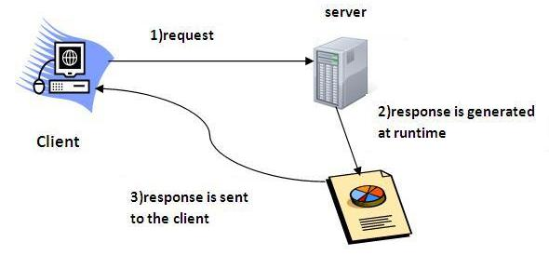
Lesson 1: Introduction to Web Services

Slide 4
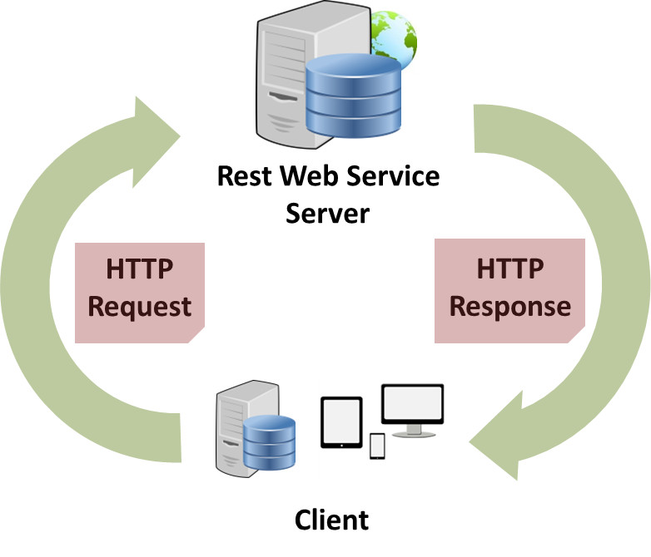
What are Web Services?
Web services are client and server applications that communicate over the World Wide Web’s (WWW) HyperText Transfer Protocol (HTTP). As described by the World Wide Web Consortium (W3C), web services provide a standard means of interoperating between software applications running on a variety of platforms and frameworks.
- How it works (High level):
Client / Server architecture and interaction over the Web
Server exponses Services.
Client sends a Request to the Server.
For a specific exposed Service.
With a PayLoad to be processed by the Service
Service processes the Request and returns a Response

Slide 5
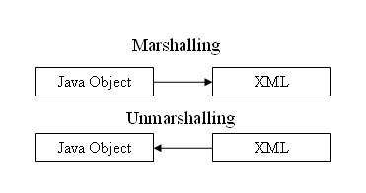
What does mean Marshalling & Unmarshalling at the «Web Service» World?
Marshalling: Object -> Other format
Unmarshalling: Other format -> Object
It’s important to mention that a request or response contains a payload, often in the form of JSON, XML, binary, etc.
Example:

Slide 6
Lesson 2: Introduction to REST

Slide 7
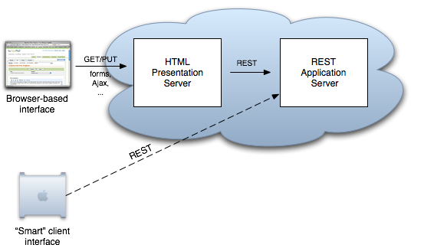
What is REST?
Representational state transfer (REST) is a style of software architecture. REST is an "architectural style" that basically exploits the existing technology and protocols of the Web.
RESTful is typically used to refer to web services implementing such an architecture, a RESTful service is exposed through a Uniform Resource Locator (URL).

Slide 8
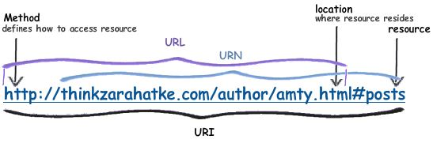
URI & URL – What is the difference?
A URI is an identifier for some resource, but a URL gives you specific information as to obtain that resource. A URI is a URL. It is now considered incorrect to use URL when describing applications. Generally, if the URL describes both the location and name of a resource, the term to use is URI.
A URI identifies a resource either by location, or a name, or both. A URI has two specializations known as URL and URN.

Slide 9
REST & RESTful, What is the difference?
"REST" is an architectural paradigm. "RESTful" describes using that paradigm.
In a strictly way, the six characteristics of REST are:
Uniform interface (This is the API of the web service, describing operations and data structures.)
Decoupled client-server interaction (Clients are separated from servers by a uniform interface.)
Stateless (No client context should be store on the server between requests)
Cacheable (Clients may cache responses, so responses must define whether they are cachable to prevent clients reusing stale or inappropriate data in response to further requests.)
Layered (A client’s connection to a server may pass directly to the service or through several intermediaries)
Extensible through code on demand (optional) (Servers may temporarily extend or customize the functionality of a client by transferring logic to be executed. e.g. client-side JavaScript)
* Services that do not conform to the above required constraints are not strictly RESTful web services.

Slide 10
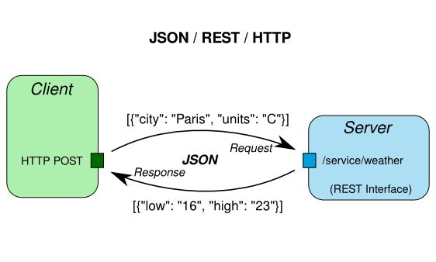
REST & RESTful, What is the difference?
In a simple way, we can say that the Fundamental RESTful characteristics are:
1. Use HTTP methods explicitly (GET, POST, PUT, DELETE, etc.)
2. Be stateless.
3. Expose directory structure-like URIs.
4. Transfer XML, JavaScript Object Notation (JSON), binary of all.

Slide 11
Sample Client Request:
A typical client GET request:
A typical client POST request:
GET /view?id=1 HTTP/1.1
User-Agent: Chrome
Accept: application/json
[CRLF]
Requested Resource (path and query string)
Request Headers
(no request body)
POST /save HTTP/1.1
User-Agent: IE
Content-Type: application/x-www-form-urlencoded
[CRLF]
name=x&id=2
Requested Resource (typically no query string)
Request Headers
Request Body (e.g. form parameters)

Slide 12
Sample Server Response:
Server response example:
HTTP/1.1 200 OK
Content-Type: text/html
Content-Length: 1337
[CRLF]
<html>
<!-- Some HTML Content. -->
</html>
Response Status
Response Headers
Response Body (content)
HTTP/1.1 500 Internal Server Error
Response Status
HTTP/1.1 201 Created
Location: /view/7
[CRLF]
Some message goes here.
Response Status
Response Header
Response Body

Slide 13
REST Resource Naming
GOOD
To insert (create) a new customer in the system, we might use: POST http://www.example.com/customers
To read a customer with Customer ID# 33245: GET http://www.example.com/customers/33245
The same URI would be used for PUT and DELETE, to update and delete, respectively
For creating a new product. POST http://www.example.com/products
GET|PUT|DELETE http://www.example.com/products/66432 For reading, updating, deleting product 66432, respectively.
BAD
GET http://api.example.com/services?op=update_customer&id=12345&format=json
GET http://api.example.com/update_customer/12345
PUT http://api.example.com/customers/12345/update

Slide 14
SOAP vs REST
SOAP is definitely the heavyweight choice for Web service access. It provides the following advantages when compared to REST:
Language, platform, and transport independent (REST requires use of HTTP)
Works well in distributed enterprise environments (REST assumes direct point-to-point communication)
Standardized
Provides significant pre-build extensibility in the form of the WS* standards
Built-in error handling
Automation when used with certain language products
REST is easier to use for the most part and is more flexible. It has the following advantages when compared to SOAP:
No expensive tools require to interact with the Web service
Smaller learning curve
Efficient (SOAP uses XML for all messages, REST can use smaller message formats)
Fast (no extensive processing required)
Closer to other Web technologies in design philosophy

Slide 15
Some technologies to create RESTful Web Services
JAX-RS is part of the Java EE6, is set of APIs, an annotation-based API for implementing RESTful web services , based on HTTP.
Jersey: Jersey provides it’s own API that extend the JAX-RS toolkit with additional features and utilities to further simplify RESTful service and client development.
Spring MVC: The Spring Web model-view-controller (MVC) framework is designed around a DispatcherServlet that dispatches requests to handlers, with configurable handler mappings, view resolution. With the introduction of Spring 3.0, the @Controller mechanism also allows you to create RESTful Web sites and applications, through the @PathVariable annotation and other features.

Slide 16
Lesson 3: SPRING @MVC REST

Slide 17
What is SPRING @MVC REST?
* RESTful Web Services built on top of Spring @MVC.
* Combines nicely with existing @MVC code
* Low learning curve for developers familiar with Spring @MVC
* Supports multiple marshaling technologies suitable for web applications (e.g., JSON)
* Spring REST is not JAX-RS!
A key difference between a traditional MVC controller and the RESTful web service controller is the way that the HTTP response is created. Rather than delegating to the view layer, object data is written directly to the HTTP response as JSON.

Slide 18
What is SPRING @MVC REST?
Spring REST on the server :
* REST Web Services endpoints are:
@Controllers
@RequestMapping: maps to handler methods.
@RequestBody: payload of request.
@ResponseBody: payload of response.
@ResponseStatus: set HTTP response code.
@PathVariable and UriTemplate: For mapping and create RESTful URIs.
* Automatic marshalling of payloads.
* Content negotiation.

Slide 19
REST Template
Spring REST on the client :
* Interact with any REST Web Services
Not limited to Spring REST Services
* Supports URI templates and automatic marshalling and unmarshalling of payloads
postForLocation(…)
postForObject(…)
getForObject(…)
delete(…)
put(…)
Etc.

Slide 21
DEMO
(ContactList Web Application)

Slide 22
David Hernandez G.
david.hernandezg@softtek.com
Related to training material
(REST Web Services)
INSTRUCTOR.
someone@softtek.com
Instructor

